Slide 1
Unsupervised learning
Mostly clustering
Terence Parr
MSDS program University of San Francisco

Slide 2
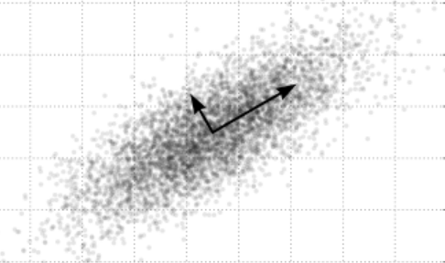
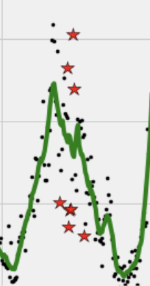
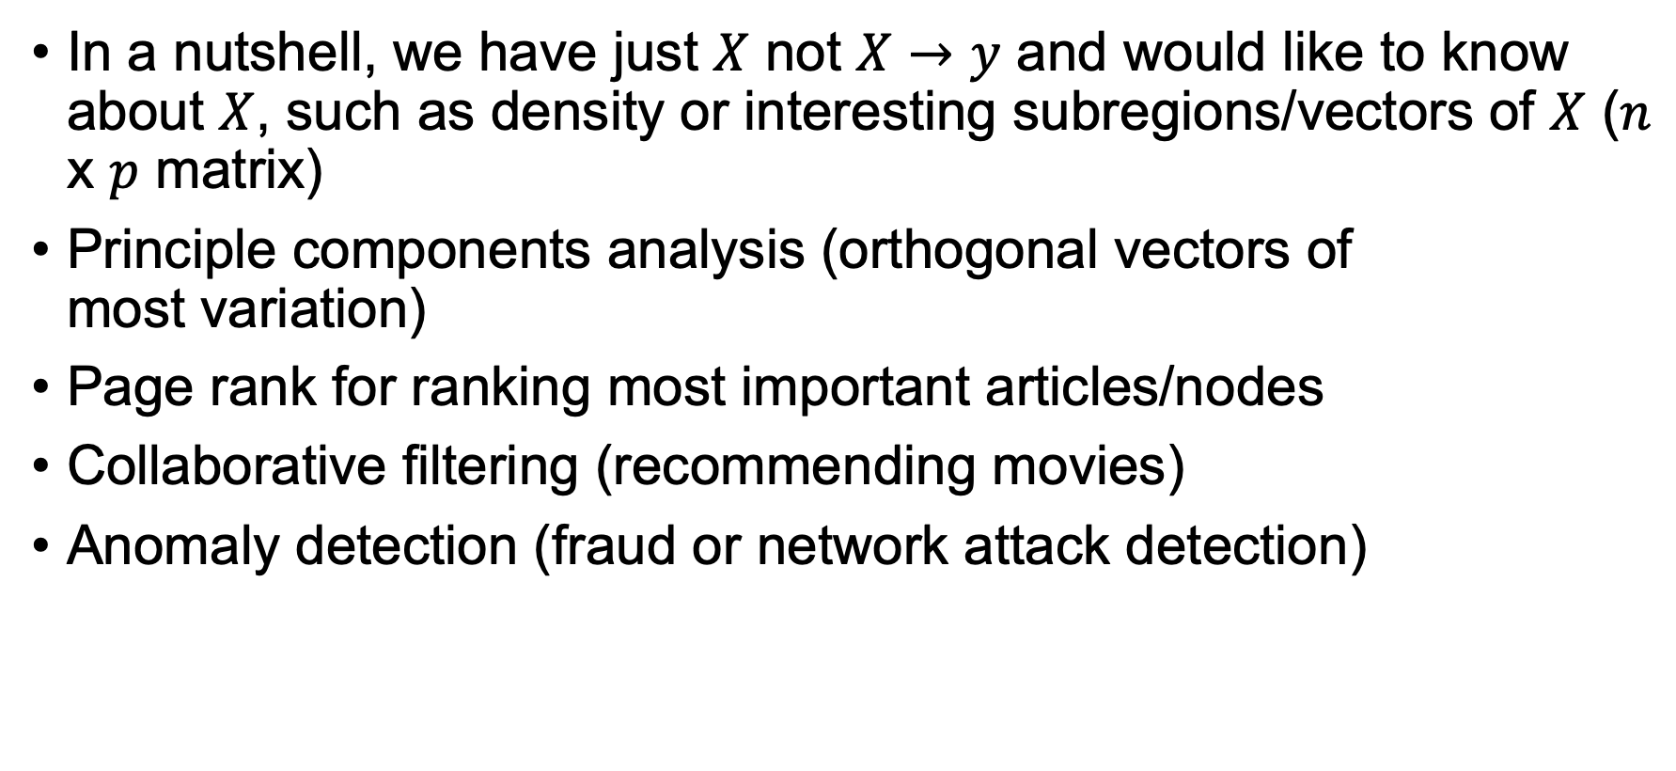
Unsupervised learning techniques…
See Chapter 14 in ESLII
In a nutshell, we have just $X$ not $X→y$ and would like to know about $X$, such as density or interesting subregions/vectors of $X$ ($n$ x $p$ matrix)
Principle components analysis (orthogonal vectors of most variation)
Page rank for ranking most important articles/nodes
Collaborative filtering (recommending movies)
Anomaly detection (fraud or network attack detection)
“Almost all of AI's recent progress is through one type, in which some input data (A) is used to quickly generate some simple response (B).”
Andrew Ng in What Artificial Intelligence Can and Can't Do Right Now
Harvard Business Review November 9, 2016

Slide 3
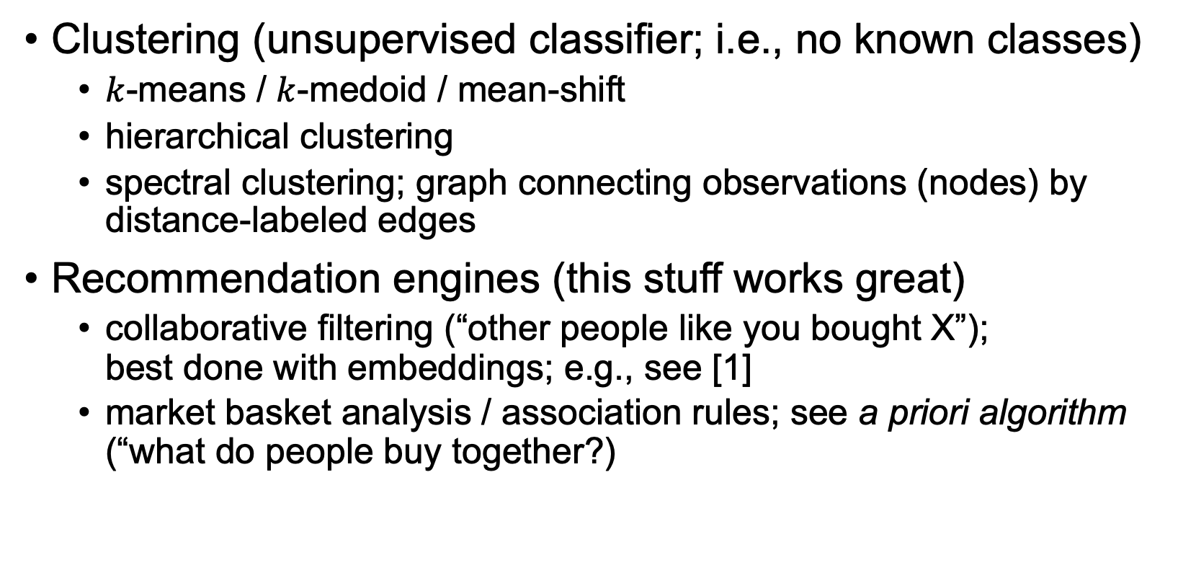
Most common unsupervised learning
Clustering (unsupervised classifier; i.e., no known classes)
$k$-means / $k$-medoid / mean-shift
hierarchical clustering
spectral clustering; graph connecting observations (nodes) by distance-labeled edges
Recommendation engines (this stuff works great)
collaborative filtering (“other people like you bought X”); best done with embeddings; e.g., see [1]
market basket analysis / association rules; see a priori algorithm (“what do people buy together?)
[1] https://github.com/fastai/fastbook/blob/master/08_collab.ipynb

Slide 4
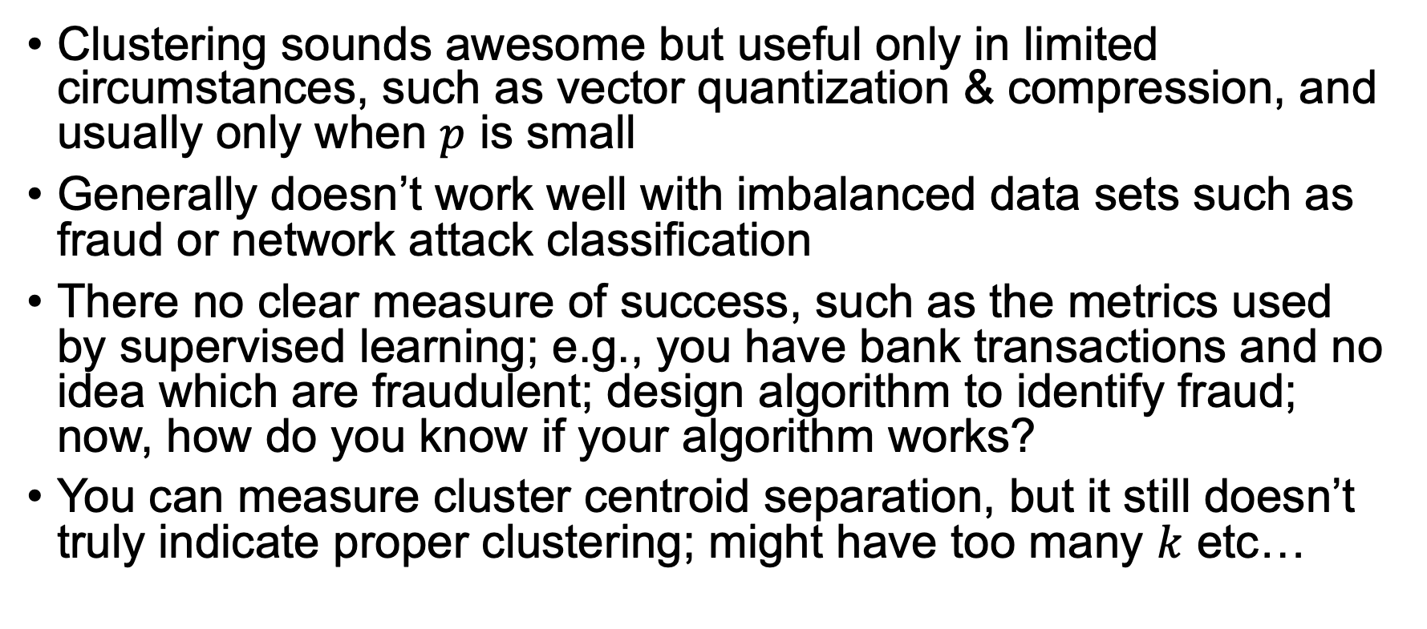
The problem with clustering is…
Clustering sounds awesome but useful only in limited circumstances, such as vector quantization & compression, and usually only when $p$ is small
Generally doesn’t work well with imbalanced data sets such as fraud or network attack classification
There no clear measure of success, such as the metrics used by supervised learning; e.g., you have bank transactions and no idea which are fraudulent; design algorithm to identify fraud; now, how do you know if your algorithm works?
You can measure cluster centroid separation, but it still doesn’t truly indicate proper clustering; might have too many $k$ etc…

Slide 5
Is clustering really what we want anyway?
Imagine clustering a customer db into 4 clusters; now what?
You have 4 groups of, say, 4 million records each; what do you do with it?
Let’s say you can identify marketing-related groups like “technerd”, “shoeshopper”, etc… What do you do with that info?
Old joke: You know you’re wasting half of your marketing money; you just don’t know which half!
Can try to market to those groups but don’t we really want to know what kind of ad people click on? Run an ad campaign and track customer->clicks; now you have a supervised problem

Slide 6
Instead can try semi-supervised learning
Sometimes getting labels is expensive or difficult, such as in medicine
Still, it’s good idea to try to turn unsupervised into supervised learning problem so let’s try to start with this “kernel” and gradually broaden the labeled data
Use a few labeled observations to get things started, such as picking the initial centroids (cluster centers); try to get your client to give you class labels for a few observations
For a good summary, see An overview of proxy-label approaches for semi-supervised learning by S. Ruder https://ruder.io/semi-supervised/index.html#selftraining

Slide 7
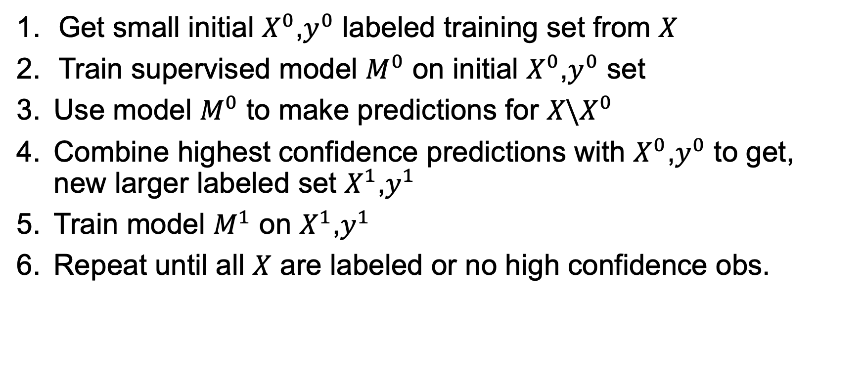
One possible self-training procedure
Get small initial $X^{0}$,$y^{0}$ labeled training set from $X$
Train supervised model $M^{0}$ on initial $X^{0}$,$y^{0}$ set
Use model $M^{0}$ to make predictions for ${X\backslash X}^{0}$
Combine highest confidence predictions with $X^{0}$,$y^{0}$ to get, new larger labeled set $X^{1}$,$y^{1}$
Train model $M^{1}$ on $X^{1}$,$y^{1}$
Repeat until all $X$ are labeled or no high confidence obs.
Selecting “highest confidence” metric requires experimentation
and requires accurate confidence or probabilities from the model
E.g., see Semi-Supervised Self-Training of Object Detection Models
http://citeseerx.ist.psu.edu/viewdoc/download?doi=10.1.1.68.3602&rep=rep1&type=pdf

Slide 8
Clustering

Slide 9
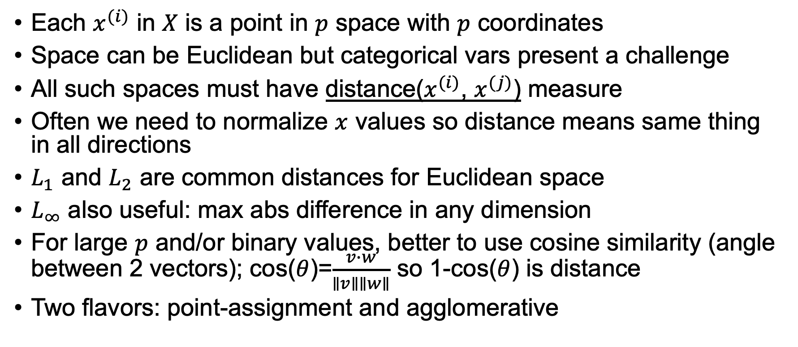
Clustering preliminaries
Each $x^{(i)}$ in $X$ is a point in $p$ space with $p$ coordinates
Space can be Euclidean but categorical vars present a challenge
All such spaces must have distance($x^{(i)}$, $x^{(j)}$) measure
Often we need to normalize $x$ values so distance means same thing in all directions
$L_{1}$ and $L_{2}$ are common distances for Euclidean space
$L_{∞}$ also useful: max abs difference in any dimension
For large $p$ and/or binary values, better to use cosine similarity (angle between 2 vectors); cos($θ$)=$\frac{v∙w}{∥v∥∥w∥}$ so 1-cos($θ$) is distance
Two flavors: point-assignment and agglomerative

Slide 10
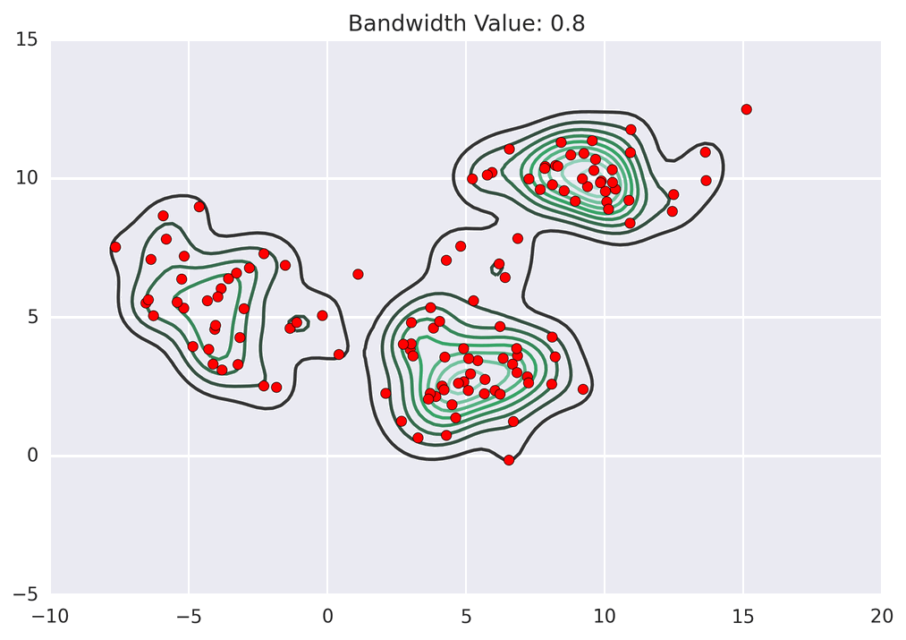
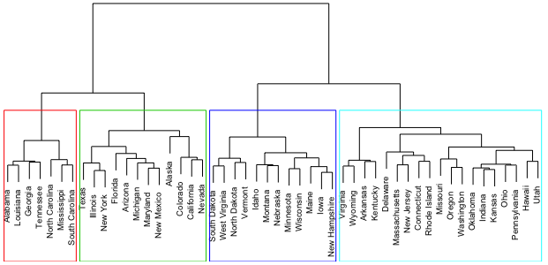
Clustering examples
k-means
mean-shift
hierarchical clustering
Images: https://developers.google.com/machine-learning/clustering/clustering-algorithms,
https://spin.atomicobject.com/2015/05/26/mean-shift-clustering/, https://uc-r.github.io/hc_clustering

Slide 11
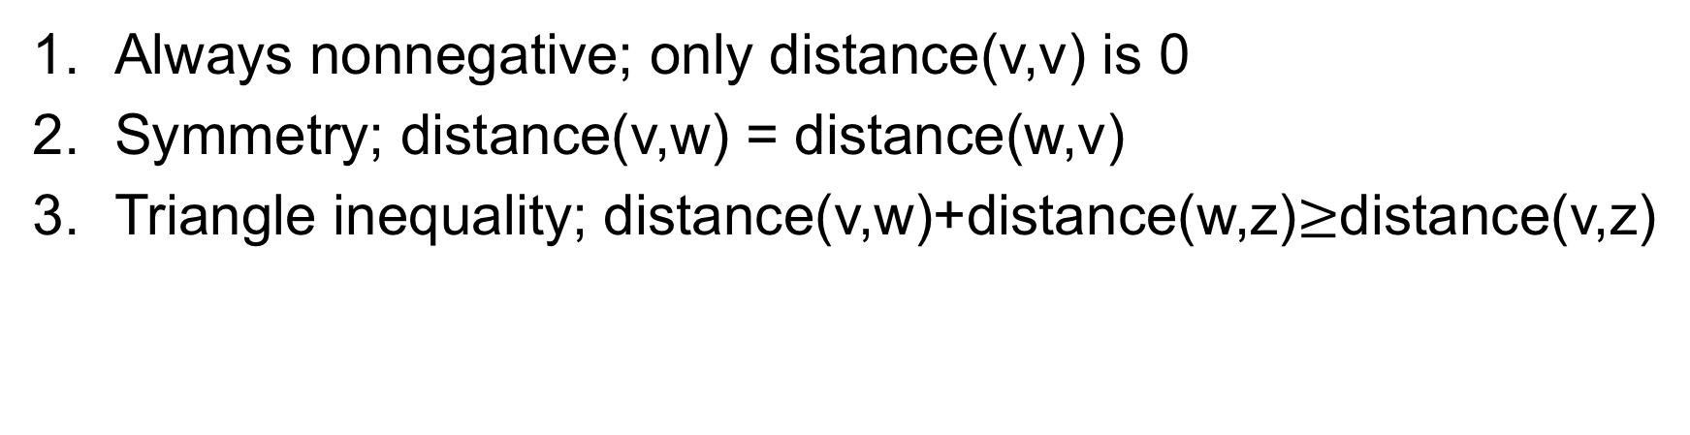
Distance measure requirements
Always nonnegative; only distance(v,v) is 0
Symmetry; distance(v,w) = distance(w,v)
Triangle inequality; distance(v,w)+distance(w,z)$≥$distance(v,z)
w
v
z
From http://www.mmds.org/; see it for more on distance metrics

Slide 12
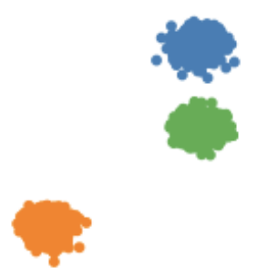
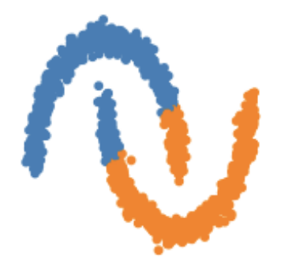
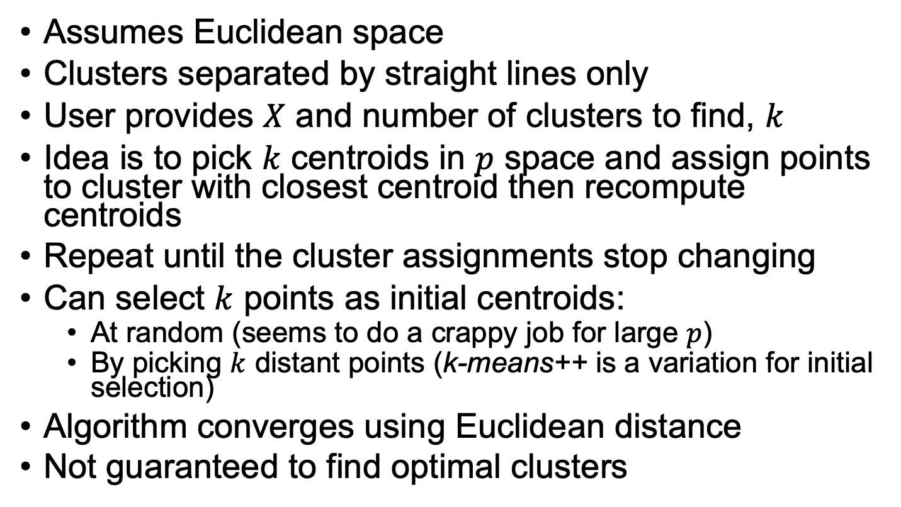
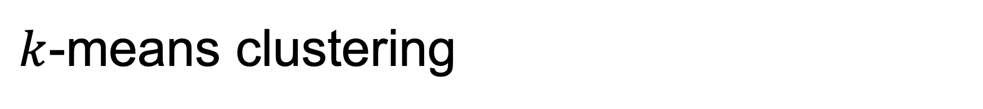
$k$-means clustering
k-means works
Assumes Euclidean space
Clusters separated by straight lines only
User provides $X$ and number of clusters to find, $k$
Idea is to pick $k$ centroids in $p$ space and assign points to cluster with closest centroid then recompute centroids
Repeat until the cluster assignments stop changing
Can select $k$ points as initial centroids:
At random (seems to do a crappy job for large $p$)
By picking $k$ distant points (k-means++ is a variation for initial selection)
Algorithm converges using Euclidean distance
Not guaranteed to find optimal clusters
k-means fails

Slide 13

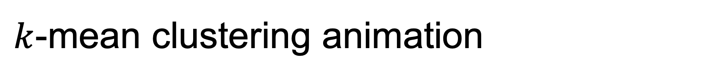
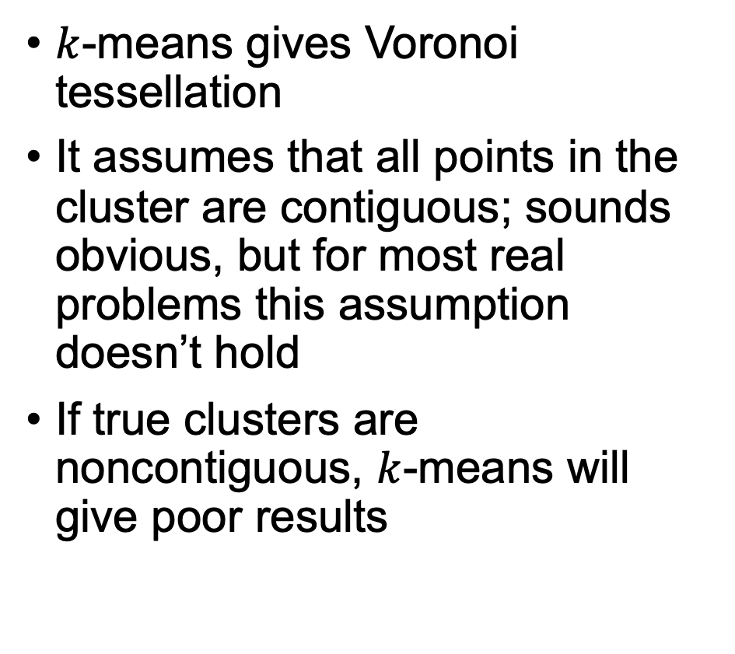
$k$-mean clustering animation
$k$-means gives Voronoi tessellation
It assumes that all points in the cluster are contiguous; sounds obvious, but for most real problems this assumption doesn’t hold
If true clusters are noncontiguous, $k$-means will give poor results
Animation from https://en.wikipedia.org/wiki/K-means_clustering

Slide 14
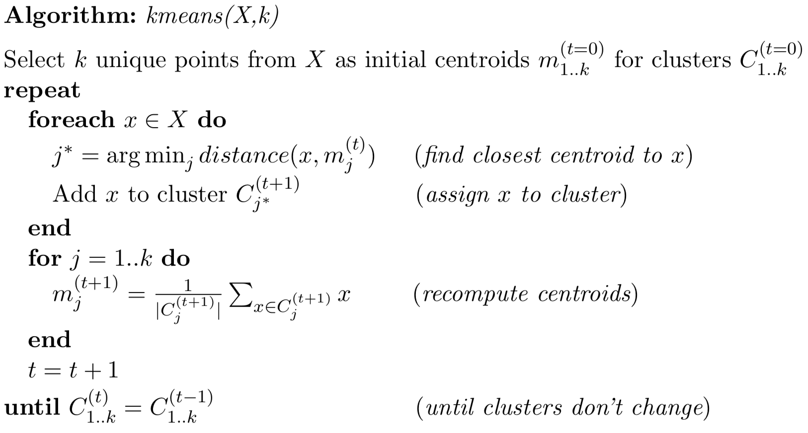
k-means algorithm

Slide 15
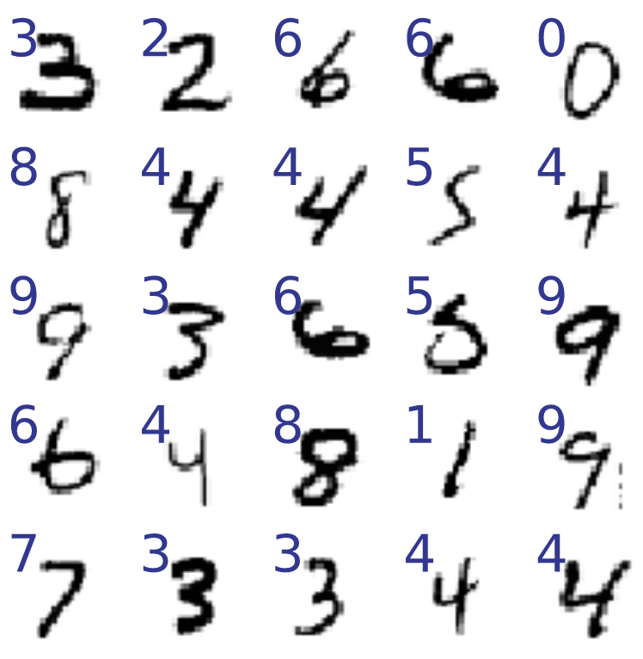
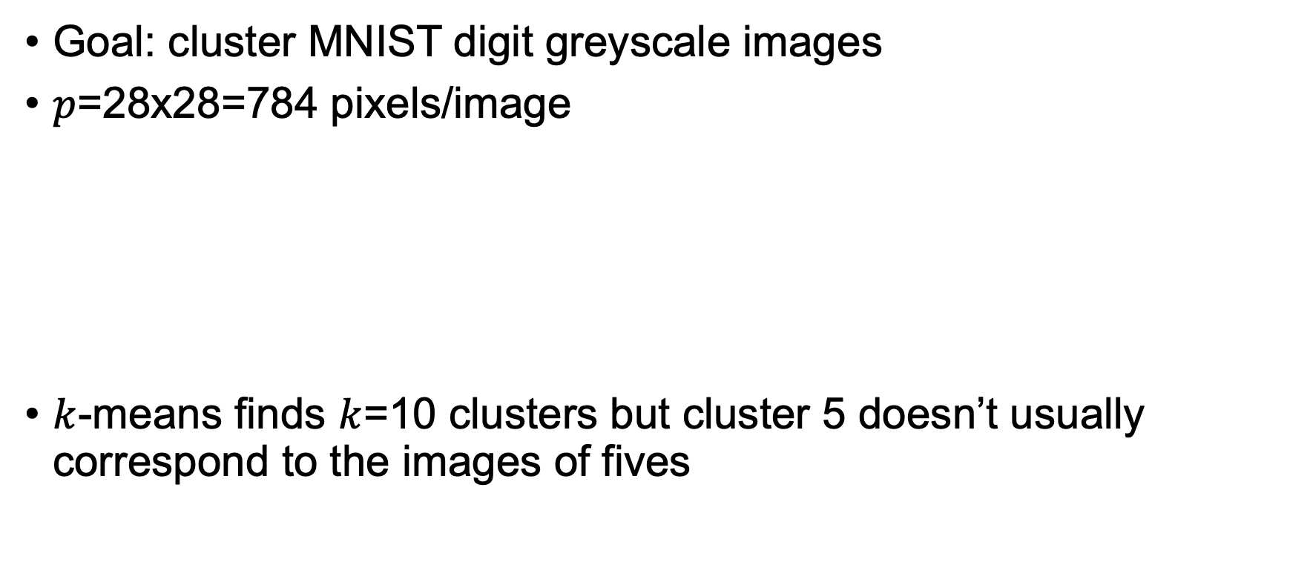
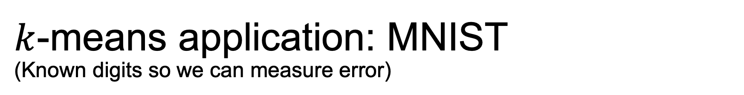
$k$-means application: MNIST (Known digits so we can measure error)
Goal: cluster MNIST digit greyscale images
$p$=28x28=784 pixels/image
$k$-means finds $k$=10 clusters but cluster 5 doesn’t usually correspond to the images of fives
X = df_digits.drop('digit', axis=1) # get just pixels
y = df_digits['digit']
kmeans = KMeans(k)
kmeans.fit(X)
y_cluster = kmeans.labels
See https://github.com/parrt/msds621/blob/master/notebooks/clustering/kmeans.ipynb

Slide 16
Testing MNIST cluster quality
For all images in each cluster, cl, get the true digits from y
y_cluster==cl indicates which images are in cluster cl
y[y_cluster==cl] indicates the true digit of each image in that cluster
Then use most common true digit as guess for that cluster’s prediction
for cl in range(0,k):
y_true_digits = y[y_cluster==cl].values # convert from class to digit
most_common_digit = np.bincount(y_true_digits).argmax()
accur = np.sum(y_true_digits==most_common_digit) / len(y_true_digits)
See https://github.com/parrt/msds621/blob/master/notebooks/clustering/kmeans.ipynb

Slide 17
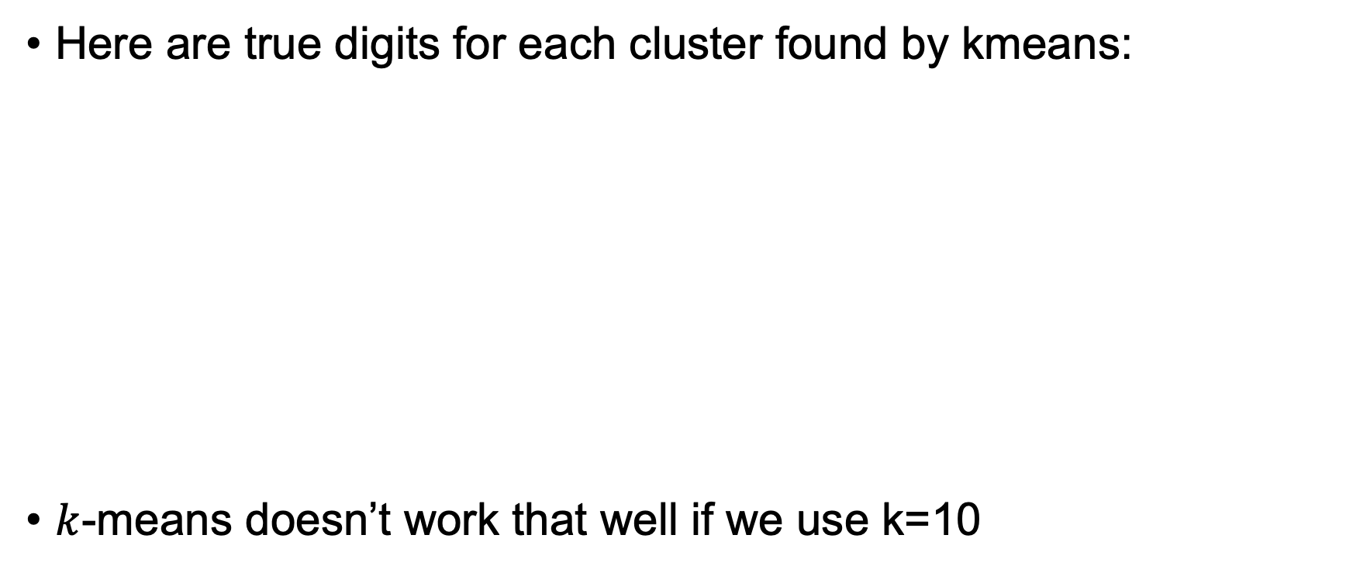
Purity and accuracy of clusters for k=10
Here are true digits for each cluster found by kmeans:
$k$-means doesn’t work that well if we use k=10
[5 8 8 8 9 3 8 8 8 6 5 5 8 8 5 8 5 0 8 8 5 8 0 5 8 8 5 9 8 8] mode = 8, gini = 0.64, accur = 53.0%
[2 2 2 2 2 2 5 2 2 2 2 3 2 2 3 2 2 2 2 2 2 2 2 2 2 2 2 2 2 2] mode = 2, gini = 0.18, accur = 90.2%
[3 3 3 3 2 5 2 2 3 3 3 5 3 3 8 0 8 3 5 5 5 8 3 3 3 5 8 3 0 3] mode = 3, gini = 0.64, accur = 53.0%
[4 0 7 9 4 4 4 7 7 9 5 4 4 9 6 4 2 7 9 4 7 4 4 7 7 3 9 4 9 4] mode = 4, gini = 0.72, accur = 35.6%
[0 0 0 0 0 0 5 0 0 0 0 0 0 6 0 0 2 0 5 0 0 5 0 0 0 0 0 0 5 0] mode = 0, gini = 0.38, accur = 77.9%
[7 9 7 9 9 9 4 7 4 9 4 7 4 9 9 9 9 7 7 9 7 4 4 7 9 7 9 4 7 7] mode = 7, gini = 0.69, accur = 43.1%
[6 6 2 6 6 6 6 6 6 6 6 6 6 4 6 6 1 6 6 6 6 2 6 6 6 0 6 6 6 6] mode = 6, gini = 0.26, accur = 85.7%
[0 0 0 0 0 0 0 0 0 0 0 0 6 0 0 0 0 0 0 0 0 0 0 0 0 0 0 0 0 9] mode = 0, gini = 0.19, accur = 89.6%
[1 1 2 1 1 6 1 5 7 1 7 1 8 4 5 1 5 1 1 2 6 5 1 8 1 5 2 1 1 1] mode = 1, gini = 0.69, accur = 51.6%
[1 1 1 1 1 1 2 1 2 1 1 9 1 9 1 1 1 3 6 3 7 3 1 9 3 1 2 1 1 6] mode = 1, gini = 0.57, accur = 64.5%
Unique labels [0 1 2 3 4 6 7 8], within class avg accuracy 64.4
Missing 5, 9!!
See https://github.com/parrt/msds621/blob/master/notebooks/clustering/kmeans.ipynb

Slide 18
Purity and accuracy of clusters for k=20
Here are true digits for each cluster found by kmeans:
[3 5 5 8 3 5 8 3 8 3 3 3 5 3 3 8 3 3 3 5 5 8 5 5 3 5 3 3 8 3] mode = 3, gini = 0.62, accur = 50.3%
[4 9 4 4 5 4 4 9 4 4 4 4 4 4 4 9 4 4 4 9 9 4 9 4 4 4 4 9 4 4] mode = 4, gini = 0.50, accur = 63.4%
[9 9 7 9 9 9 7 7 7 9 7 7 7 7 7 9 7 5 7 4 9 7 9 9 7 4 4 7 7 9] mode = 7, gini = 0.50, accur = 66.3%
[1 1 1 1 1 1 1 2 1 1 1 9 1 1 1 3 6 1 3 1 1 1 6 2 1 1 1 1 1 1] mode = 1, gini = 0.30, accur = 83.6%
[2 2 2 2 2 2 2 2 2 2 2 2 2 2 2 2 2 2 2 2 2 2 2 2 2 2 2 3 2 2] mode = 2, gini = 0.09, accur = 95.5%
…
[8 8 8 8 8 8 7 8 8 5 8 8 8 8 8 8 8 2 3 8 8 8 8 8 8 8 8 8 8 8] mode = 8, gini = 0.35, accur = 80.0%
[9 7 9 4 4 9 4 9 9 4 9 7 9 9 9 9 4 9 9 4 7 9 4 9 4 7 9 4 4 4] mode = 9, gini = 0.61, accur = 48.3%
[2 2 2 2 2 3 2 2 2 2 2 2 2 2 2 2 2 2 2 2 2 2 2 2 2 2 2 2 2 2] mode = 2, gini = 0.13, accur = 93.0%
[7 7 9 4 9 7 9 7 7 9 9 3 7 9 3 9 9 9 7 9 9 7 9 9 4 6 4 9 9 9] mode = 9, gini = 0.71, accur = 38.9%
[7 7 7 7 7 7 7 7 7 7 7 7 7 7 7 7 7 2 7 7 7 7 7 7 7 7 7 2 7 7] mode = 7, gini = 0.09, accur = 95.2%
[4 4 6 2 4 7 4 4 4 9 4 4 4 4 4 4 4 7 4 9 4 4 4 4 9 9 7 9 4 4] mode = 4, gini = 0.67, accur = 45.8%
[0 0 0 0 0 0 0 0 0 0 0 2 5 5 0 0 0 0 0 0 0 0 0 0 0 0 5 0 0 0] mode = 0, gini = 0.20, accur = 89.1%
Unique labels [0 1 2 3 4 5 6 7 8 9], within class avg accuracy 73.6
See https://github.com/parrt/msds621/blob/master/notebooks/clustering/kmeans.ipynb

Slide 19
Purity and accuracy of clusters for k>20
k=100:
k=200:
k=250:
Naturally, we’d have to combine these k classes to group into 10 digits
Unique labels [0 1 2 3 4 5 6 7 8 9], within class avg accuracy 88.6
Unique labels [0 1 2 3 4 5 6 7 8 9], within class avg accuracy 90.8
Unique labels [0 1 2 3 4 5 6 7 8 9], within class avg accuracy 91.4
See https://github.com/parrt/msds621/blob/master/notebooks/clustering/kmeans.ipynb

Slide 20
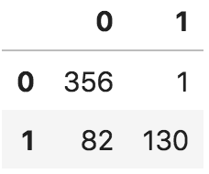
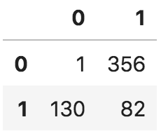
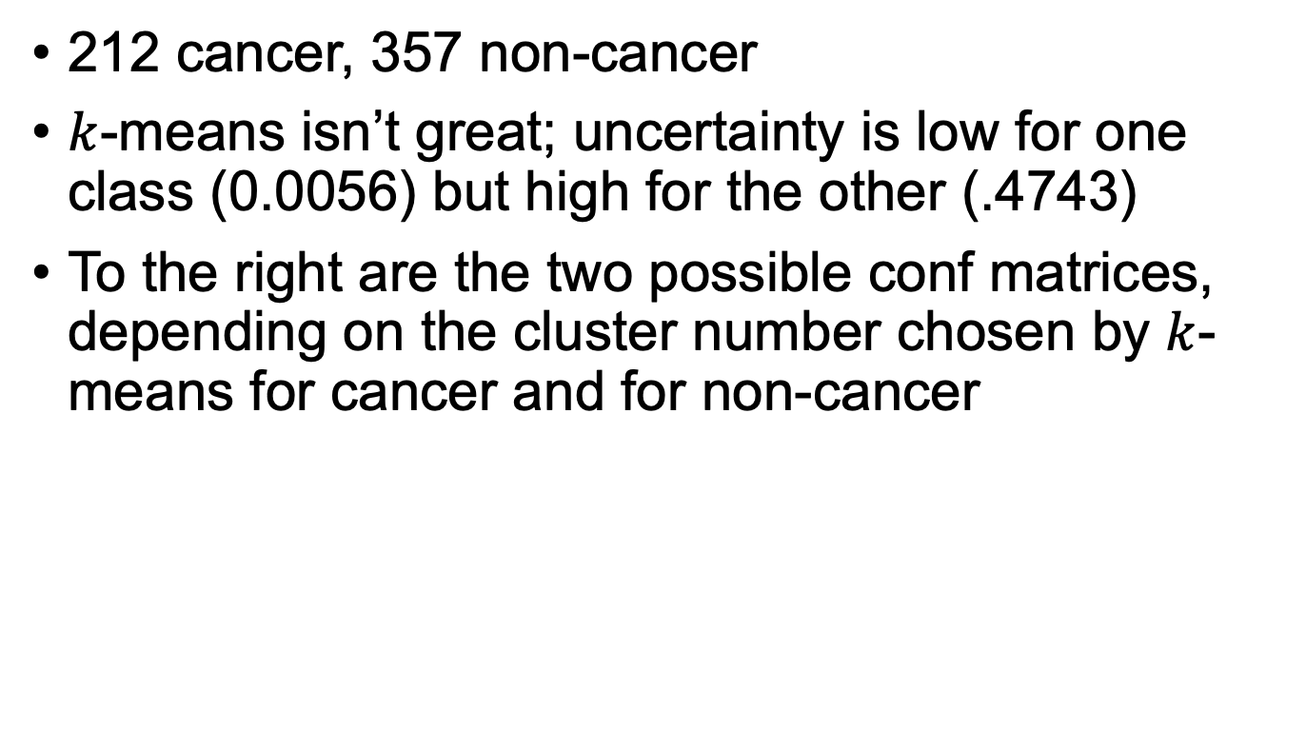
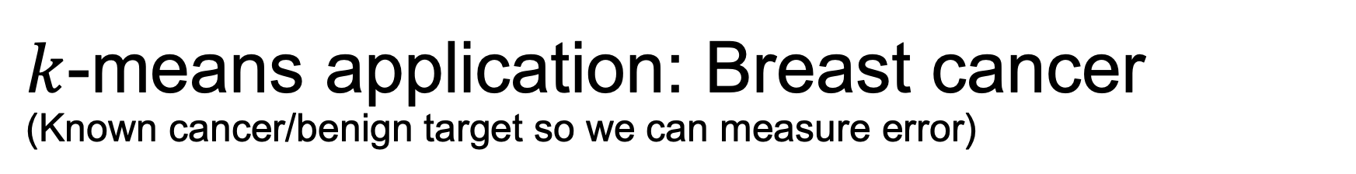
$k$-means application: Breast cancer (Known cancer/benign target so we can measure error)
212 cancer, 357 non-cancer
$k$-means isn’t great; uncertainty is low for one class (0.0056) but high for the other (.4743)
To the right are the two possible conf matrices, depending on the cluster number chosen by $k$-means for cancer and for non-cancer
predicted
actual
predicted
kmeans = KMeans(n_clusters=2, init='k-means++')
kmeans.fit(X)
y_pred = kmeans.predict(X)
cancer = np.where(y==0)[0]
benign = np.where(y==1)[0]
print( gini(y_pred[benign]), gini(y_pred[cancer]) )
actual

Slide 21
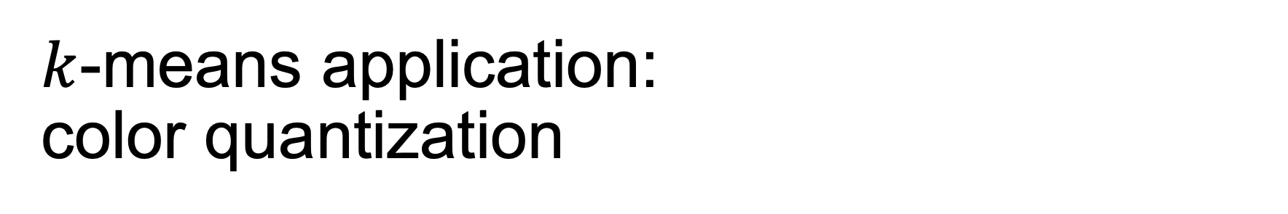
$k$-means application: color quantization
no blue
Color pictures typically use lots of unique colors, possibly 10s of thousands
Each pixel in the image has Red/Green/Blue colors, 1 byte per RGB = 3 bytes (24 bits)
Each RGB is a 3D coordinate of color: (R, G, B), with possibly tens of thousands of unique combinations
Example with just red/green (omit blue):
See https://scikit-learn.org/stable/auto_examples/cluster/plot_color_quantization.html
Image from https://en.wikipedia.org/wiki/Color_quantization

Slide 22
Color quantization cont’d
(R,G,B) takes 3 bytes per pixel which makes images really big
If a picture only has 256 unique colors we can map all (R,G,B) vectors to a single byte; the color “index” 0..255 points into a color palette with the full (R,G,B) vectors; 3x compression for each pixel, which is massive compression
If picture has more than 256 colors, we can cluster in RGB space with k=256 and it will group similar colors together; then we pick the centroid as the colors in the palette

Slide 23
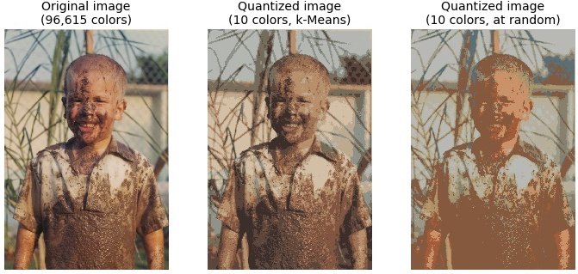
Color quantization example, k=10
See https://github.com/parrt/msds621/blob/master/notebooks/clustering/kmeans.ipynb

Slide 24
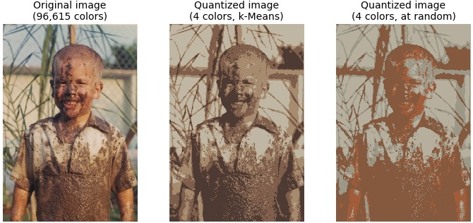
Color quantization example, k=4

Slide 25
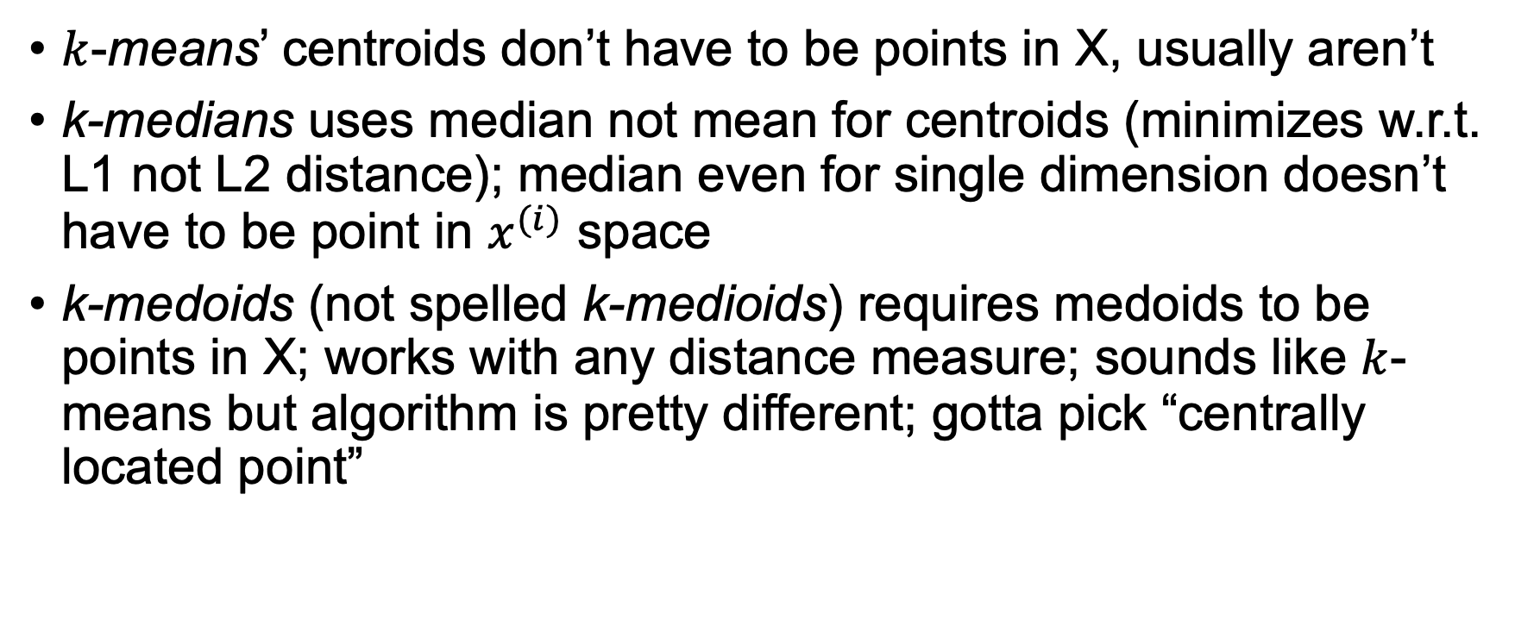
Confusion point
$k$-means’ centroids don’t have to be points in X, usually aren’t
k-medians uses median not mean for centroids (minimizes w.r.t. L1 not L2 distance); median even for single dimension doesn’t have to be point in $x^{(i)}$ space
k-medoids (not spelled k-medioids) requires medoids to be points in X; works with any distance measure; sounds like $k$-means but algorithm is pretty different; gotta pick “centrally located point”

Slide 26
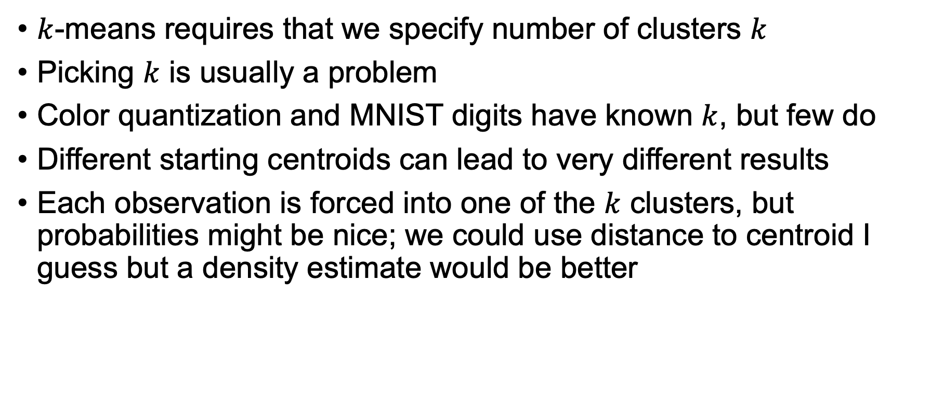
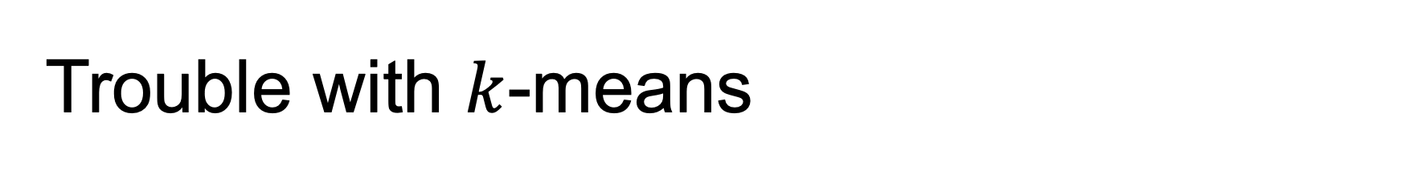
Trouble with $k$-means
$k$-means requires that we specify number of clusters $k$
Picking $k$ is usually a problem
Color quantization and MNIST digits have known $k$, but few do
Different starting centroids can lead to very different results
Each observation is forced into one of the $k$ clusters, but probabilities might be nice; we could use distance to centroid I guess but a density estimate would be better

Slide 27
Hierarchical (agglomerative) clustering
Idea: put every point into its own singleton cluster; repeatedly group two closest clusters into a meta-cluster until just one cluster left
Can also stop when distance between clusters are sufficiently large
We need a cluster distance metric; called the linkage criterion
Simplest linkage is just the distance between cluster centroids
Result is a tree of clusters, one cluster per level
We get all possible clusters

Slide 28
Dendograms
Dendogram is a tree of clusters, one cluster per level
Distance from node to children reflects between-cluster-metric
Image from https://www.statisticshowto.datasciencecentral.com/hierarchical-clustering/

Slide 29
Between-cluster distance metrics (linkage)
Warning: statisticians coining terms again!
Minimum distance between any two points in the cluster (single linkage); tends not to get compact clusters and can get chains of points
Max distance between point pairs (complete linkage); tends to get compact clusters but points can be closer to other clusters than those within their cluster
Average distance of all point pairs from two clusters (group average linkage); tries to get compact clusters that are far apart
Ward’s method minimizes within-cluster variance; merge pair with smallest prospective variance at each step
Images from http://saedsayad.com/clustering_hierarchical.htm

Slide 30
Effect of between-cluster-metric
Max distance between points
Min distance between points
Image from https://uc-r.github.io/hc_clustering

Slide 31
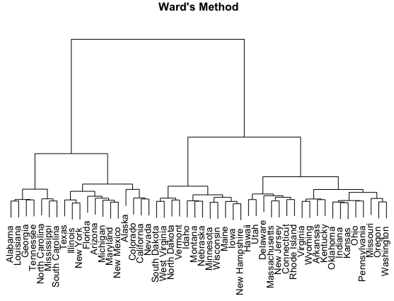
Ward’s method
Image from https://uc-r.github.io/hc_clustering

Slide 32
Non-numeric clustering
How do you cluster documents?
Can use edit distance or Jaccard similarity between text docs
Maybe convert words to Glove word vectors
Try your own word embeddings from corpus
But what about tabular data with nominal categorical variables?
In non-numeric space, what is a centroid vector?
There are similarity measures for categoricals, but I’m not a big fan, particularly with mixed numeric and categorical data

Slide 33
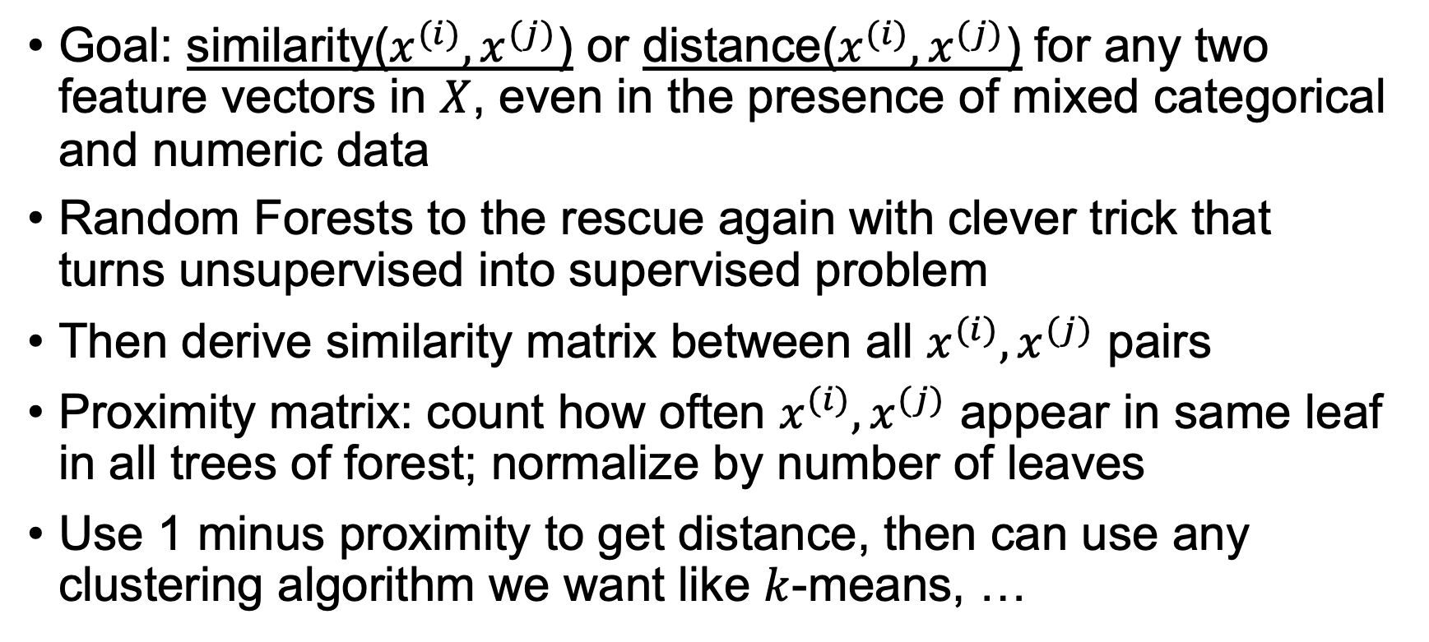
Breiman’s RF clustering
Goal: similarity($x^{(i)},x^{(j)}$) or distance($x^{(i)},x^{(j)}$) for any two feature vectors in $X$, even in the presence of mixed categorical and numeric data
Random Forests to the rescue again with clever trick that turns unsupervised into supervised problem
Then derive similarity matrix between all $x^{(i)},x^{(j)}$ pairs
Proximity matrix: count how often $x^{(i)},x^{(j)}$ appear in same leaf in all trees of forest; normalize by number of leaves
Use 1 minus proximity to get distance, then can use any clustering algorithm we want like $k$-means, …
See https://www.stat.berkeley.edu/~breiman/RandomForests/cc_home.htm

Slide 34
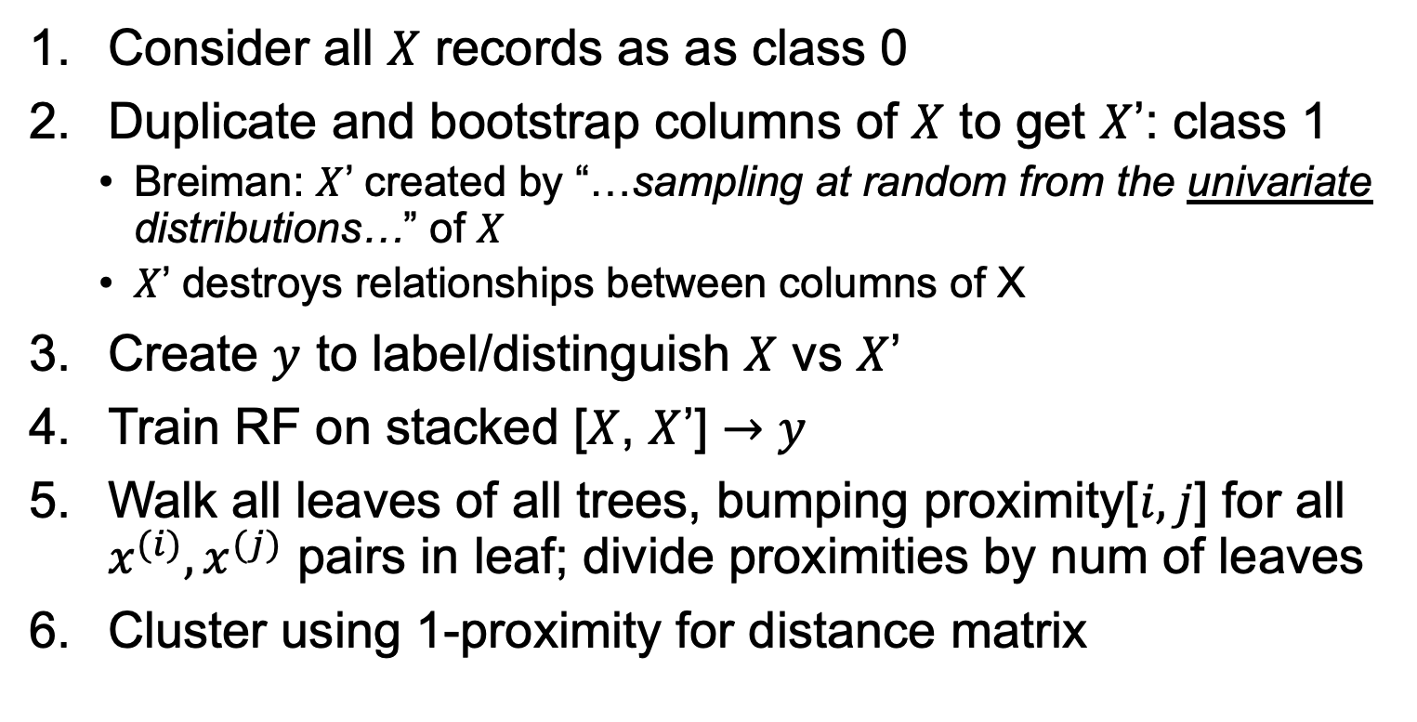
Random Forest distance metric
Consider all $X$ records as as class 0
Duplicate and bootstrap columns of $X$ to get $X$’: class 1
Breiman: $X$’ created by “…sampling at random from the univariate distributions…” of $X$
$X$’ destroys relationships between columns of X
Create $y$ to label/distinguish $X$ vs $X$’
Train RF on stacked [$X$, $X$’] $→$ $y$
Walk all leaves of all trees, bumping proximity[$i,j$] for all $x^{(i)},x^{(j)}$ pairs in leaf; divide proximities by num of leaves
Cluster using 1-proximity for distance matrix

Slide 35
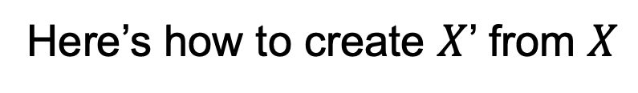
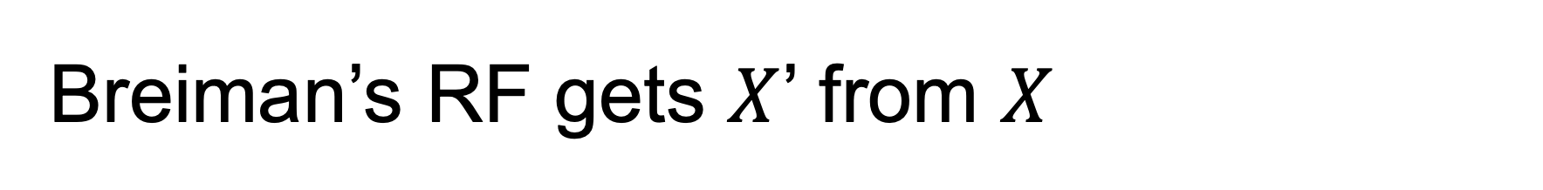
Breiman’s RF gets $X$’ from $X$
Here’s how to create $X$’ from $X$
def df_scramble(X : pd.DataFrame) -> pd.DataFrame:
X_rand = X.copy()
for colname in X:
X_rand[colname] = \
np.random.choice(X[colname], len(X), replace=True)
return X_rand

Slide 36
Breiman’s RF conjures up supervised from unsupervised
def conjure_twoclass(X : pd.DataFrame)\
-> (pd.DataFrame, pd.Series):
X_rand = df_scramble(X)
X_synth = pd.concat([X, X_rand], axis=0)
y_synth = np.concatenate([np.zeros(len(X)),
np.ones(len(X_rand))],
axis=0)
return X_synth, pd.Series(y_synth)
Train an RF model to recognize structure between variables,
but goal is simply co-existence in leaves

Slide 37
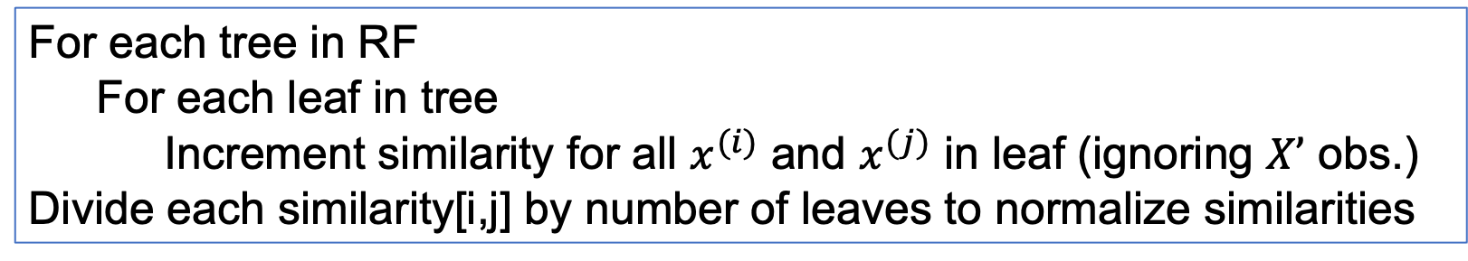
Computing RF similarity matrix
For each tree in RF
For each leaf in tree
Increment similarity for all $x^{(i)}$ and $x^{(j)}$ in leaf (ignoring $X’$ obs.)
Divide each similarity[i,j] by number of leaves to normalize similarities

Slide 38
More on RFs for similarity
Similarity Forests http://biorxiv.org/cgi/reprint/258699v1
Unsupervised Learning With Random Forest Predictors https://horvath.genetics.ucla.edu/html/RFclustering/RFclustering/RandomForestHorvath.pdf

